Slide 1
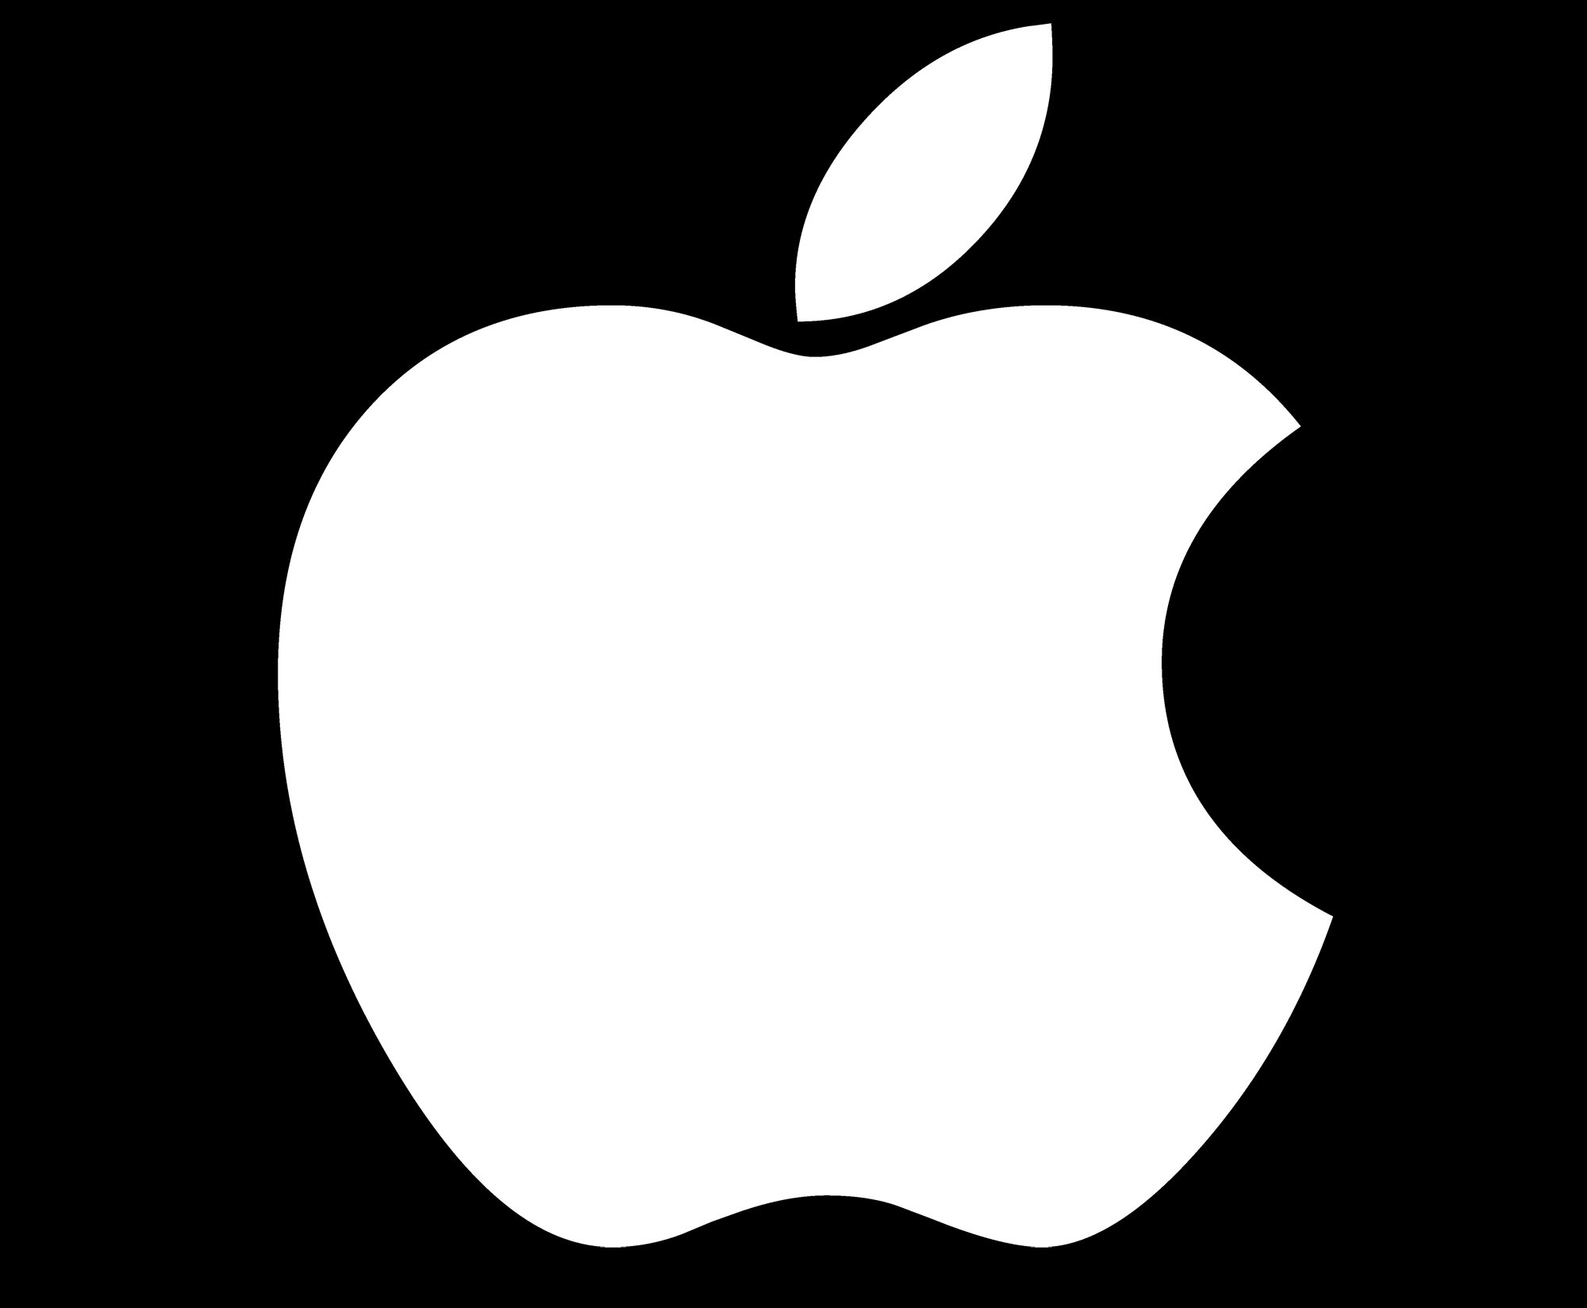
How APPLE captured
Indian market
Presented by:
Yash Gupta (2205053)
TY IT DA-2

Slide 2
INTRODUCTION
Apple Computer Company was founded on April 1, 1976 by Steve Jobs, Steve Wozniak & Ronald Wayne as a partnership.
Apple has been a leading player in the US consumer electronic market.
The first iPhone was launched by Steve Jobs on January 9, 2007.
During the initial years of it’s launch, Apple faced a major rejection in the Indian market as the shipment and assembly cost from US to India consumed a much higher premium thus making iPhones very expensive in India.
The problem continued till further more launches of iPhones.

Slide 3

Problem Statement
India is a fast growing market with a huge population. It also falls in top 10 growing IT industries of the world.
With so much of opportunities, Apple lacked in capturing the market of India with their devices.
So with my case study, we’ll look at what were the changes that apple implemented to capture the Indian market.

Slide 4
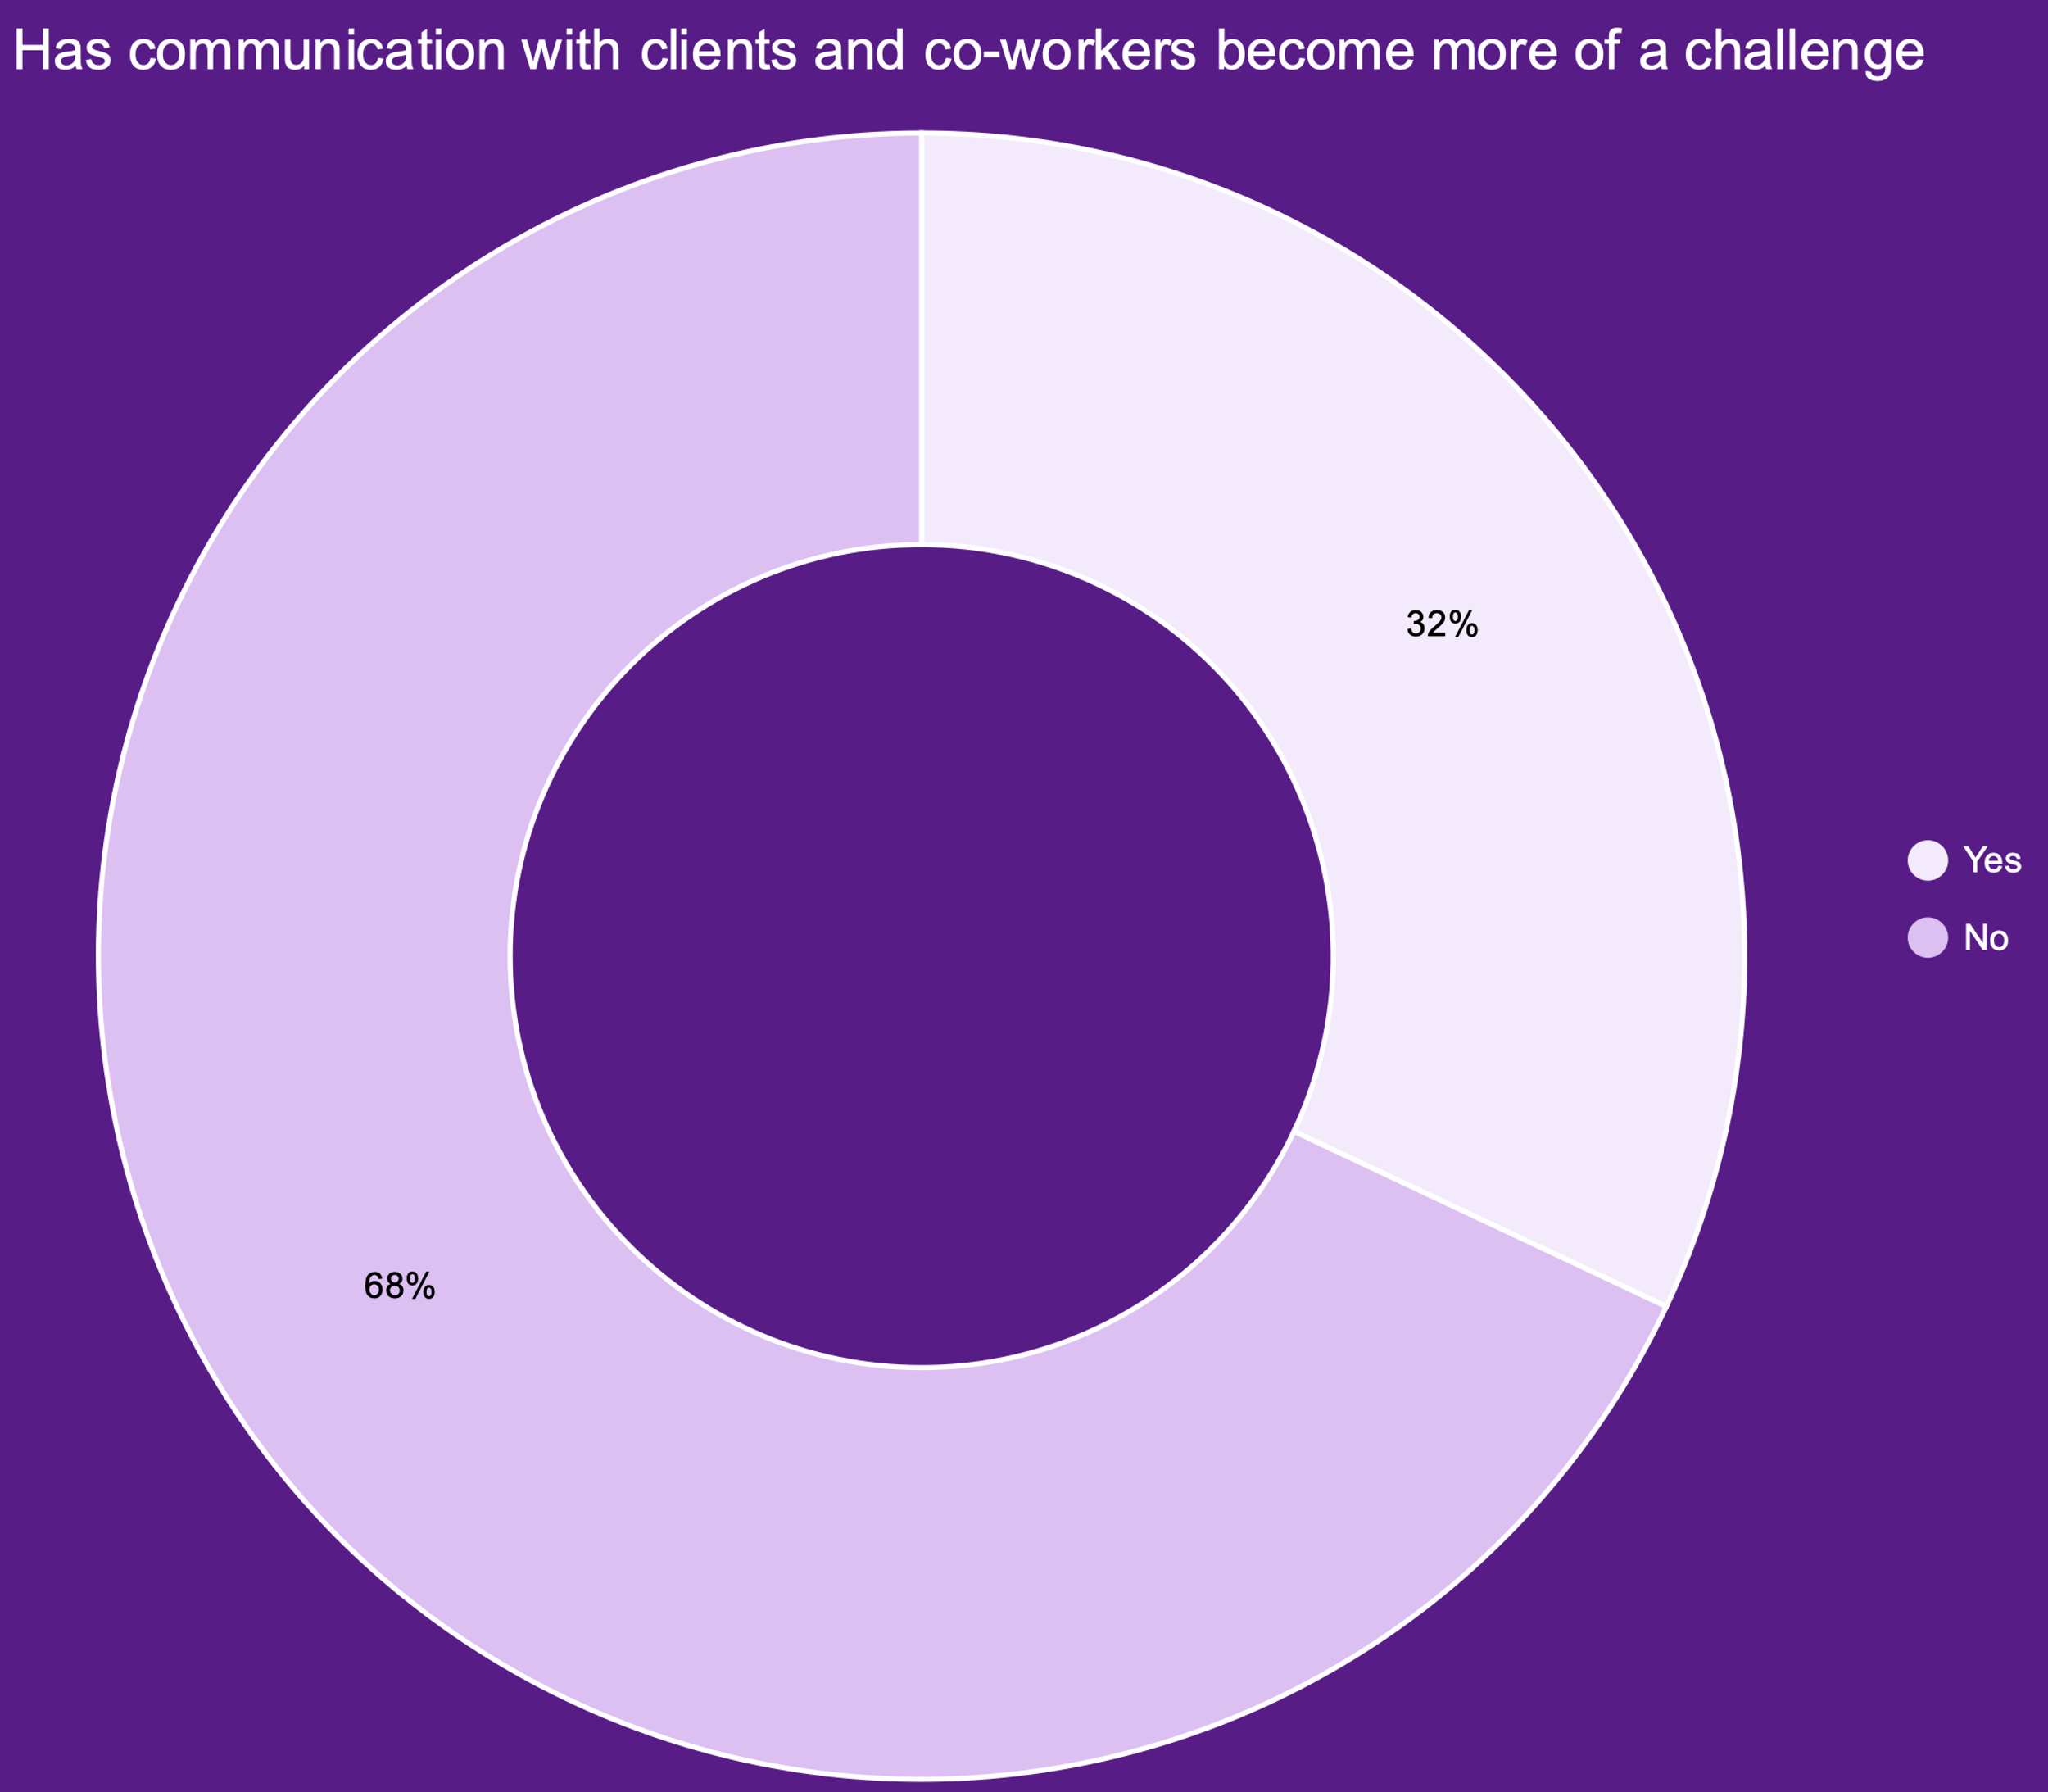
Literature Survey
To understand the problem, we need to first start with a survey to know what actually people think about apple products.
According to Ministry of Information and Broadcasting secretary Apurva Chandra, India has over 1.2 billion mobile phone users and 600 million smart phone users and out of these 600 million smartphone users, only 40-50 million users use iPhones.
And out of the remaining 550 million smartphone users,
68% of people find Apple products expensive and the remaining
32% of people don’t use iPhones for various other reasons.

Slide 5
Why do people purchase iPhones in India?
People purchase iPhones in India for a variety of reasons, including:
Status symbol: For many people in India, owning an iPhone is seen as a status symbol and a sign of wealth and success.
Brand loyalty: Apple has a strong brand image and loyal customer base, and many people who have used iPhones in the past prefer to stick with the same brand.
Design and user experience: iPhones are known for their sleek and premium design, as well as their user-friendly interface and intuitive features.
App ecosystem: The Apple App Store offers a vast selection of high-quality apps and games, which is a major draw for many users.
Privacy and security: Apple is known for its strong privacy and security measures, which may be a priority for some users.
Longevity: iPhones are known for their longevity and durability, which may make them a more attractive investment over time compared to other smartphones that may need to be replaced more frequently.

Slide 6
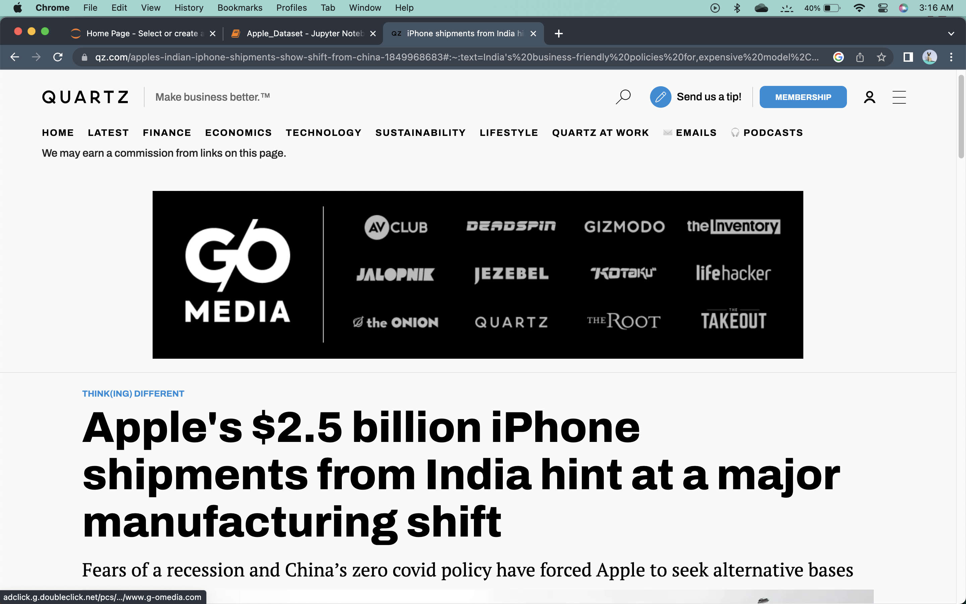
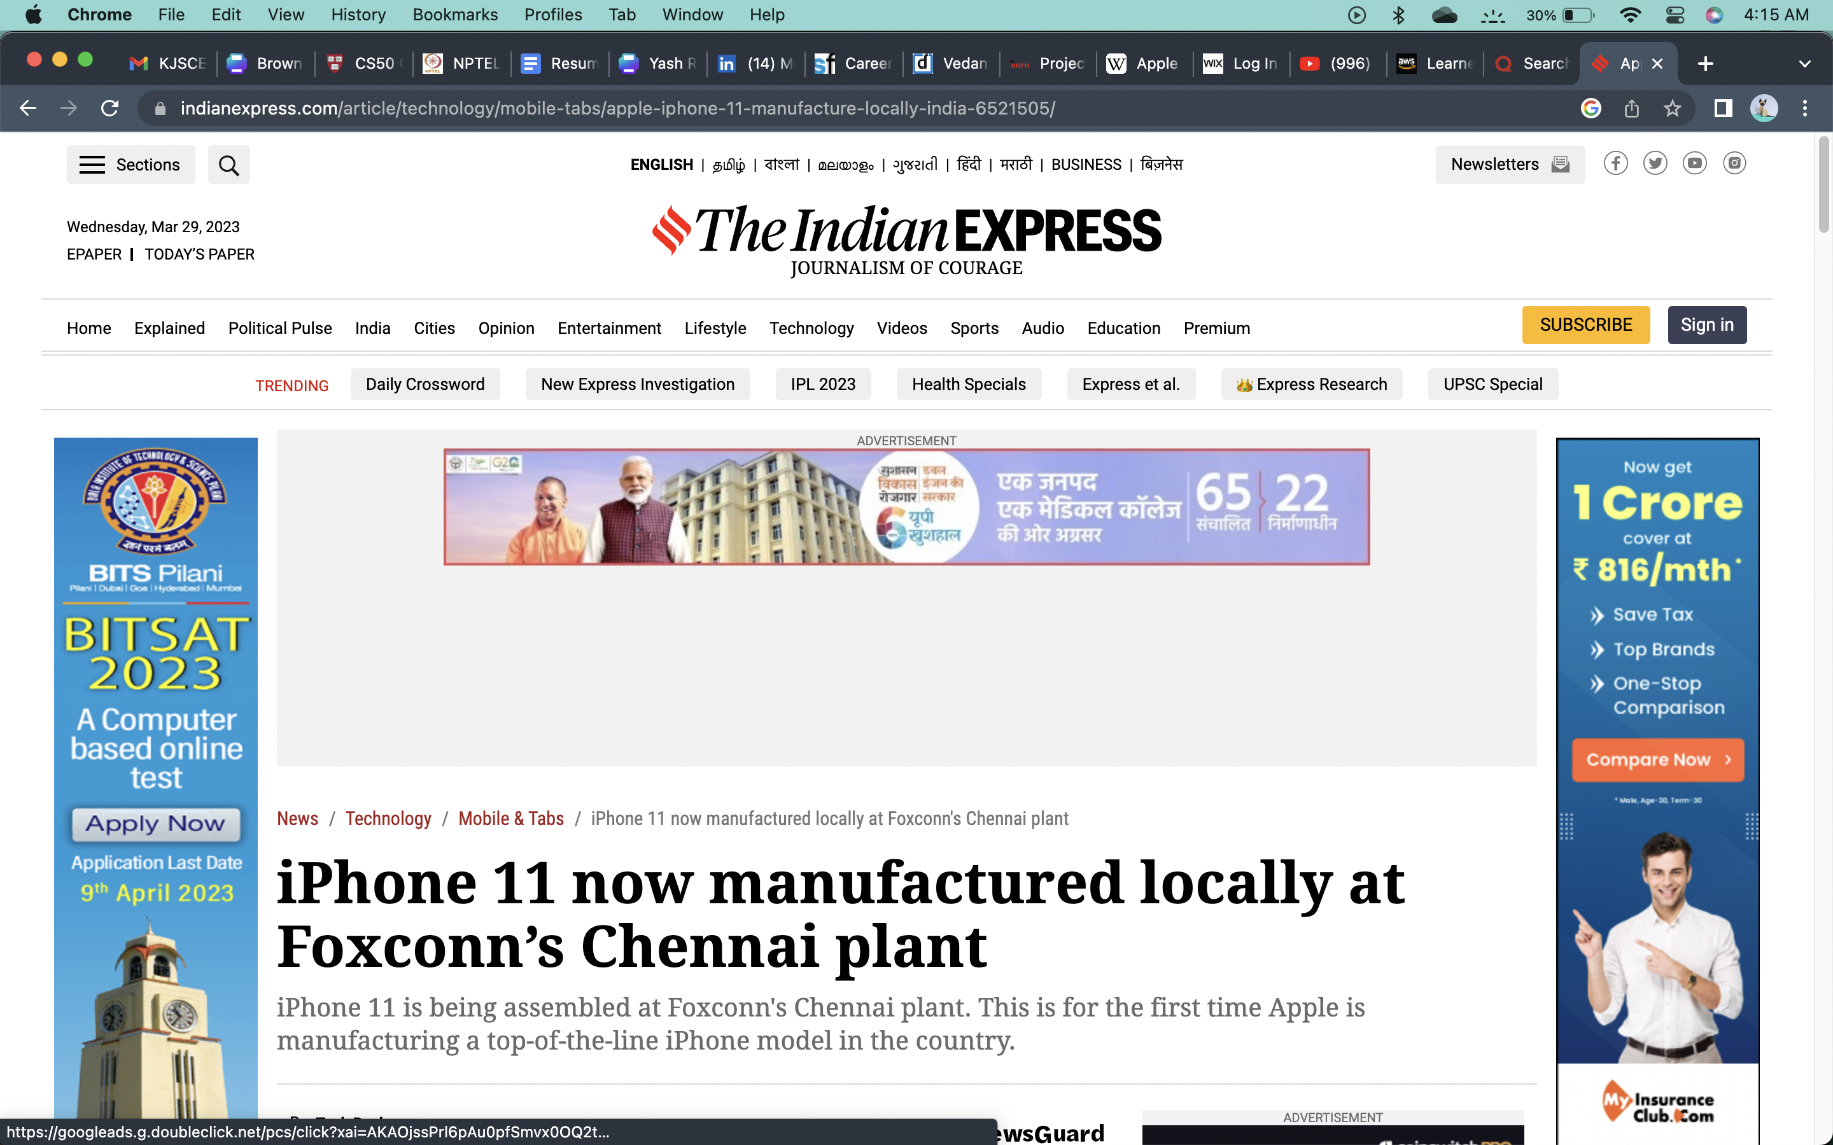
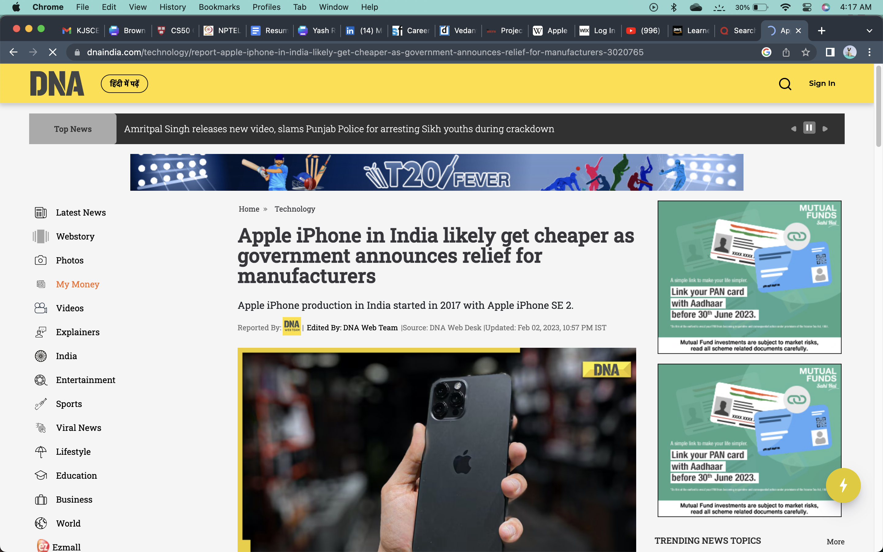
So what actually happened that changed Apple’s destiny in Indian market?
In the year 2019, Apple saw a massive growth in sales of iPhone 11, which became one of the best selling phones of Apple in Indian market.
Later next year, after covid-19 pandemic settled for a while and after the launch of iPhone 12, Apple confirmed their first manufacturing unit in India and later in 2021, they started manufacturing iPhones in India which saved them a lot of money that was paid as custom duty and hence they were able to cut the prices and offer various discounts on their phones.

Slide 7

Data Collection
So for this case study, I have collected two types of datasets:–
Sales data of iPhones in India before they were manufactured in India.
Sales data of iPhones in India after they were manufactured in India.
The data is of an e-commerce platform called Flipkart.

Slide 8
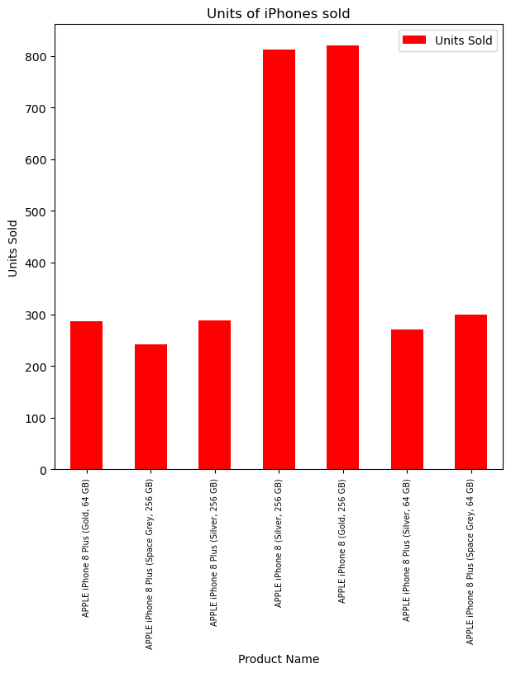
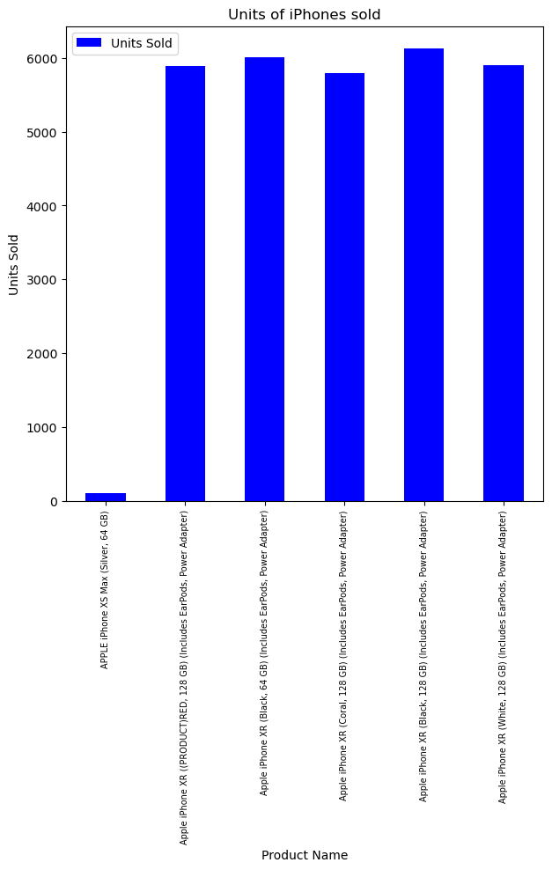
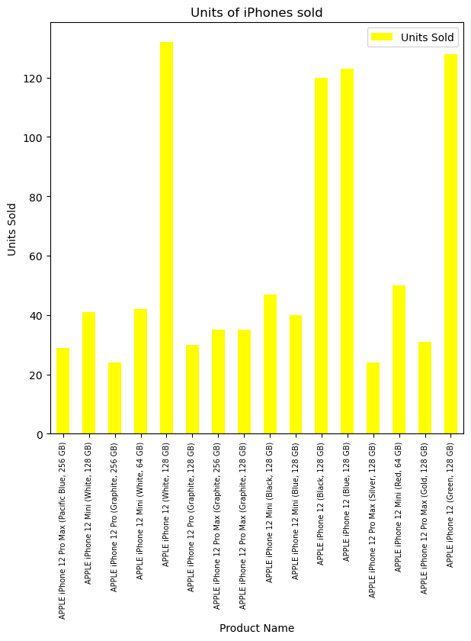
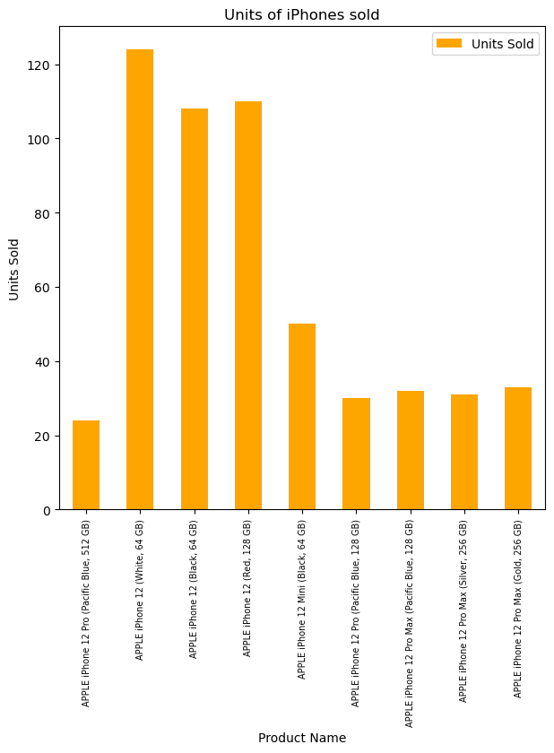
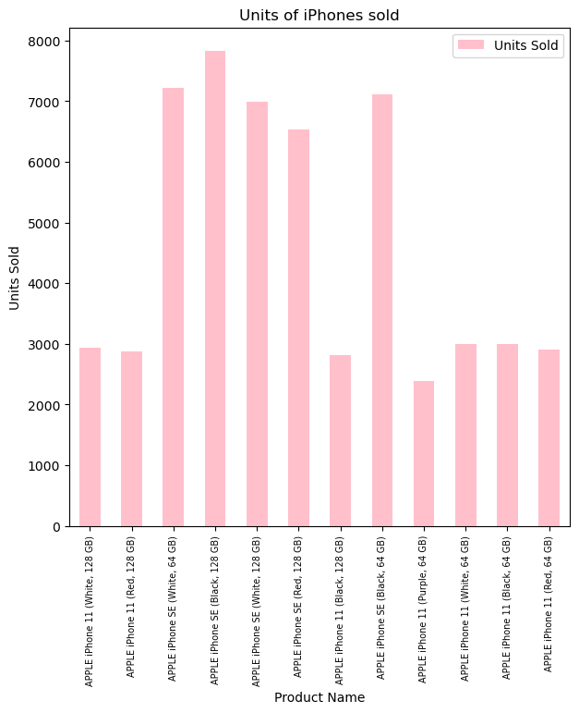
Data Visualization
Here you can see the no. of iPhone units sold on Flipkart before Apple shifted their manufacturing in India

Slide 9
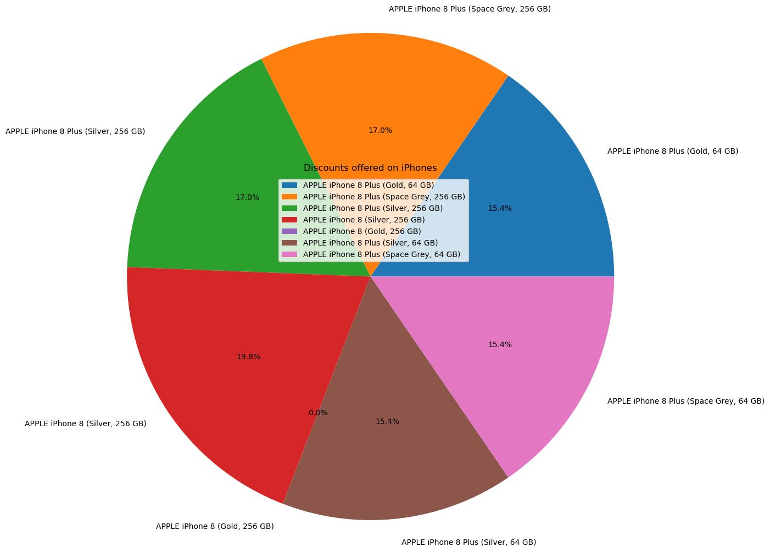
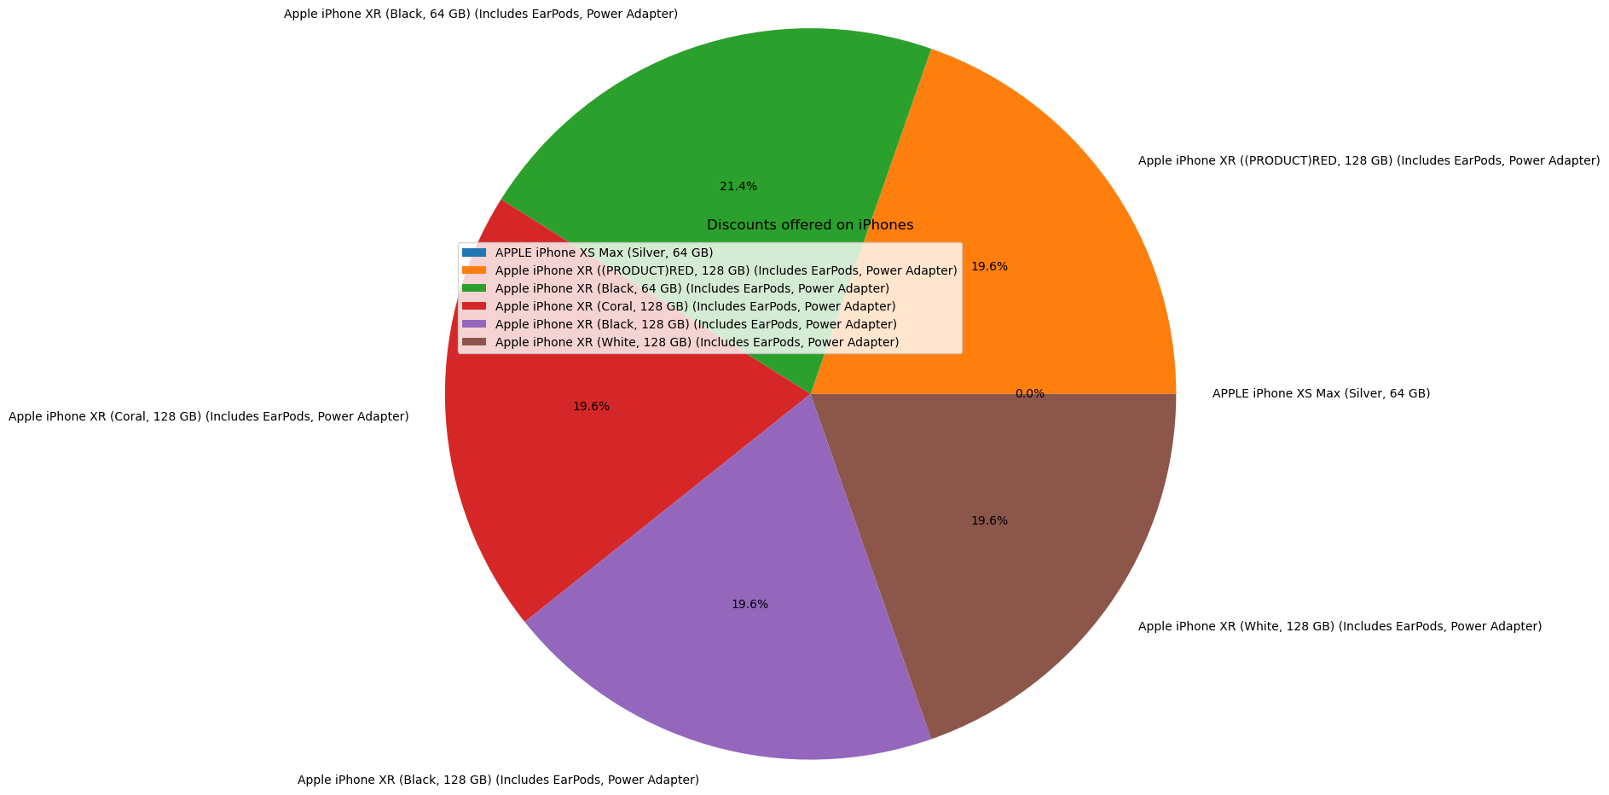
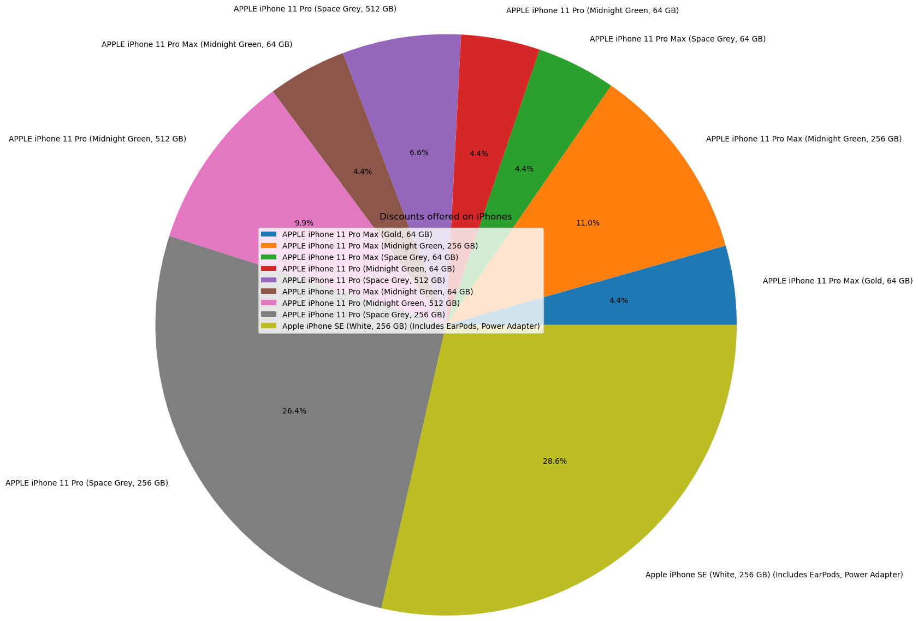
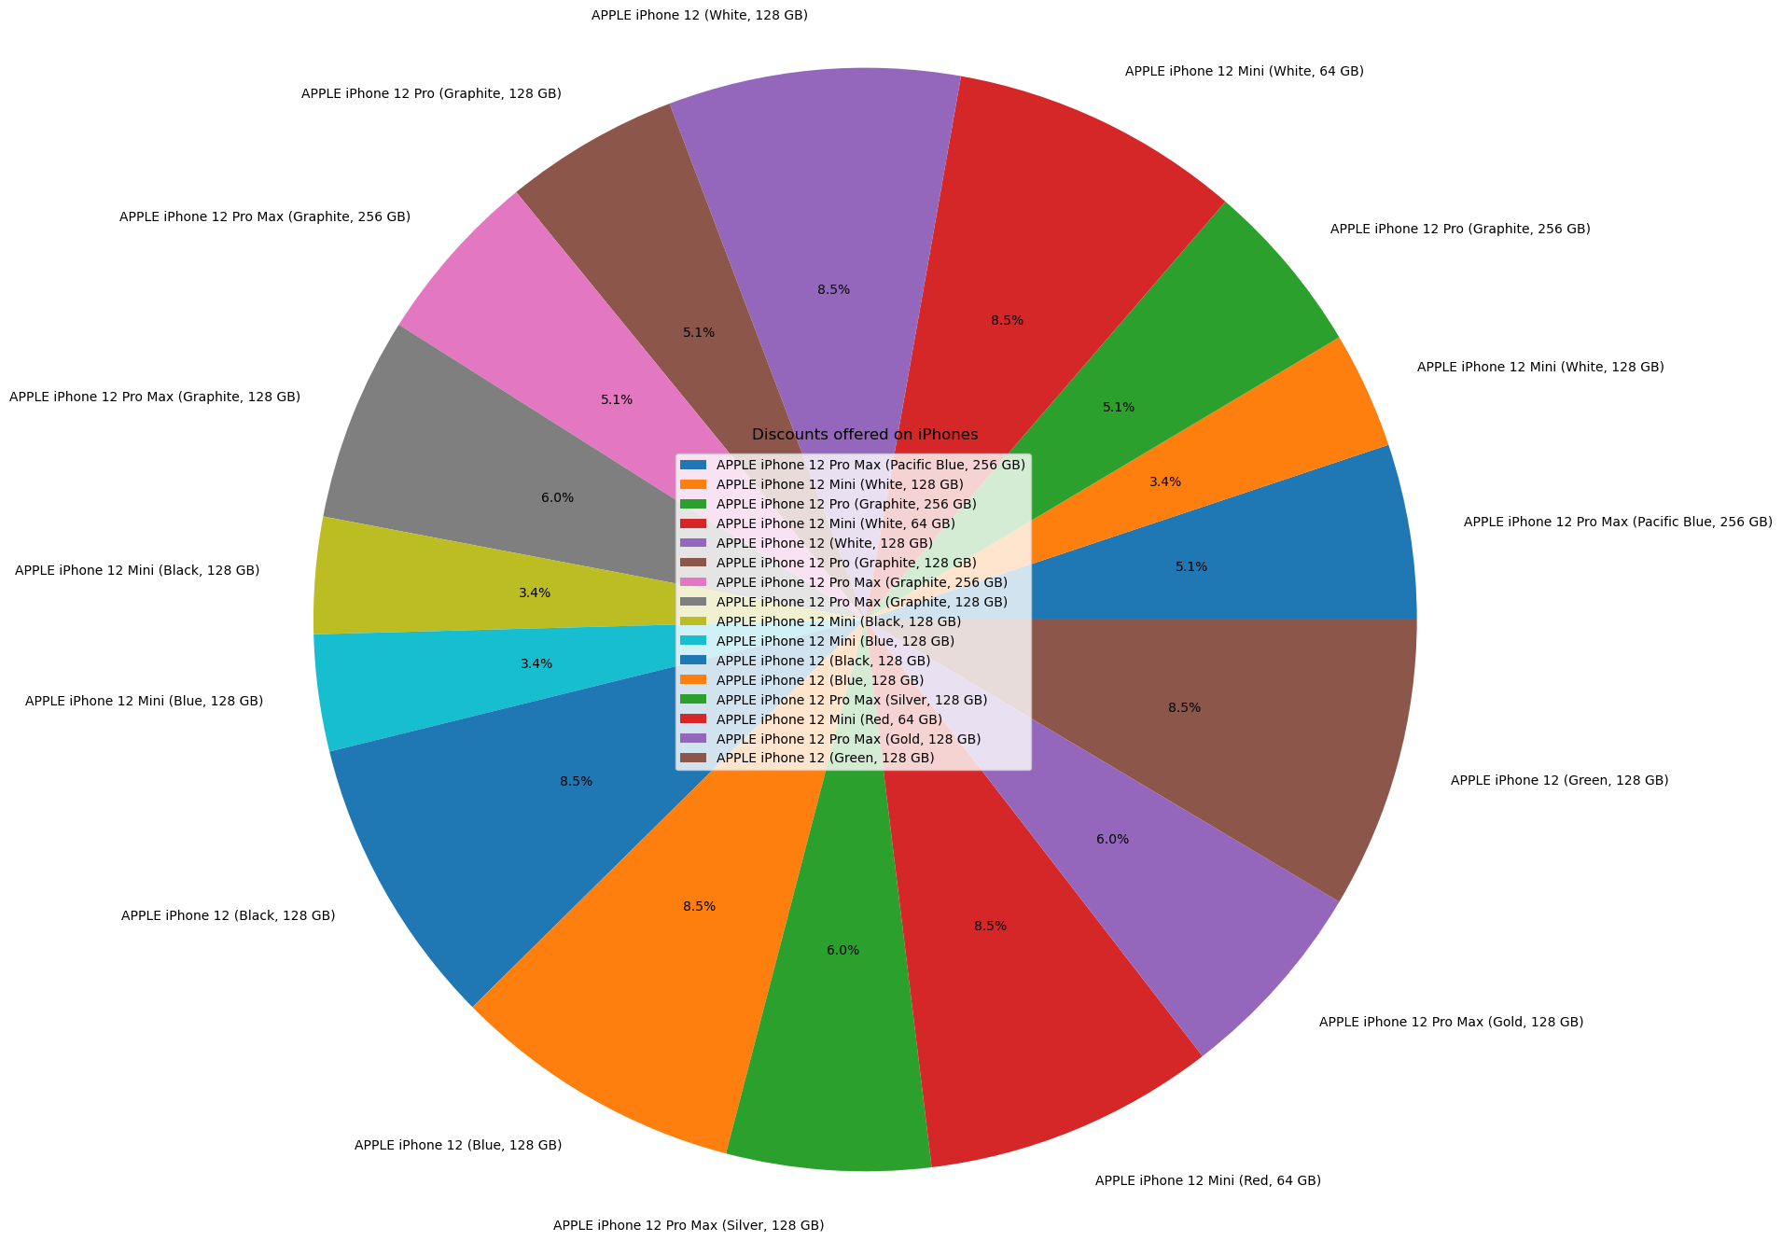
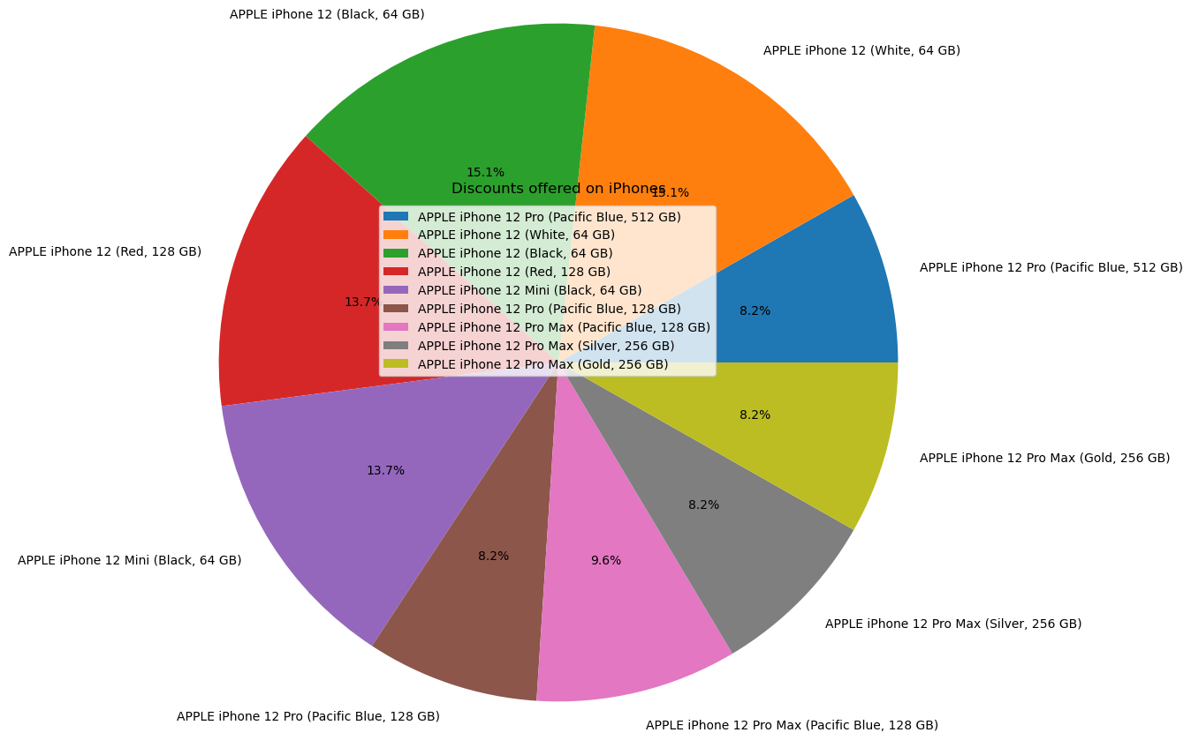
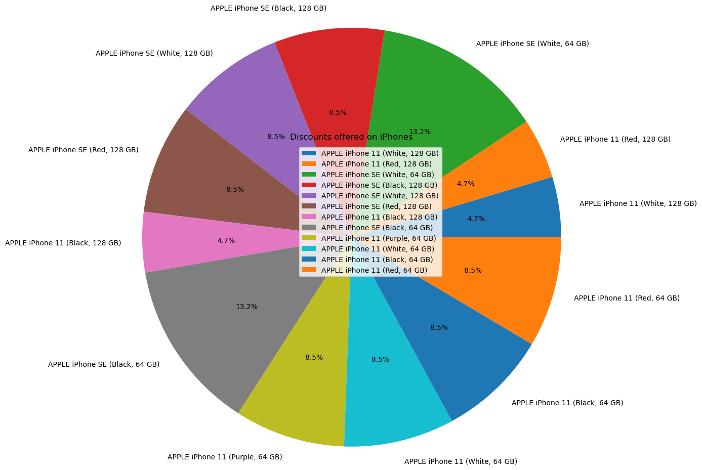
Data Visualization
Here you can see the discounts that were offered on iPhones before the setup of manufacturing unit in India

Slide 10
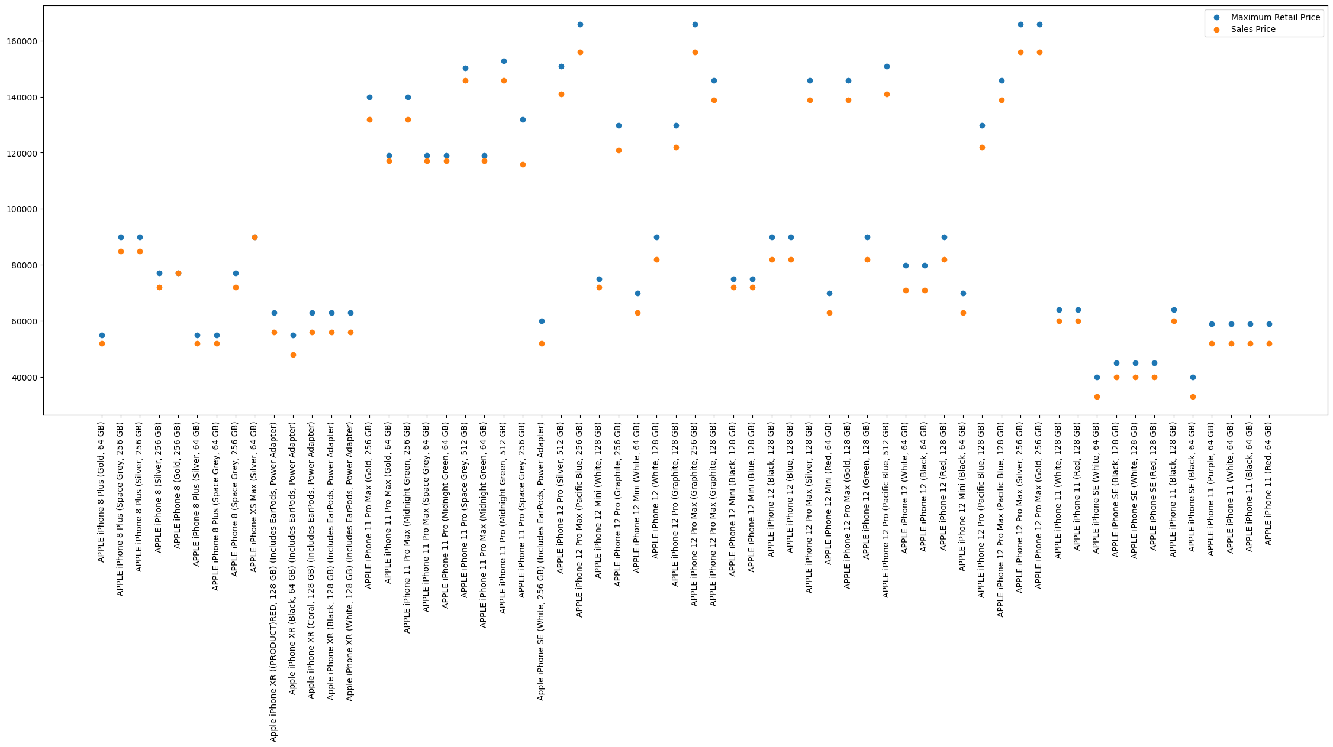
Data Visualization
Here’s a graph that shows the MRP and the sales prices of various iPhones before they were manufactured in India

Slide 11
After shifting their manufacturing unit in India, Apple saw a rapid growth in Indian market.

Slide 12
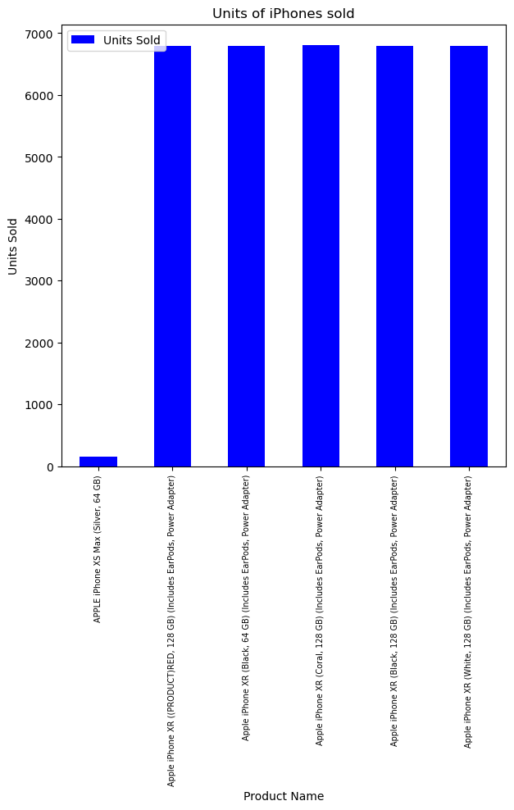
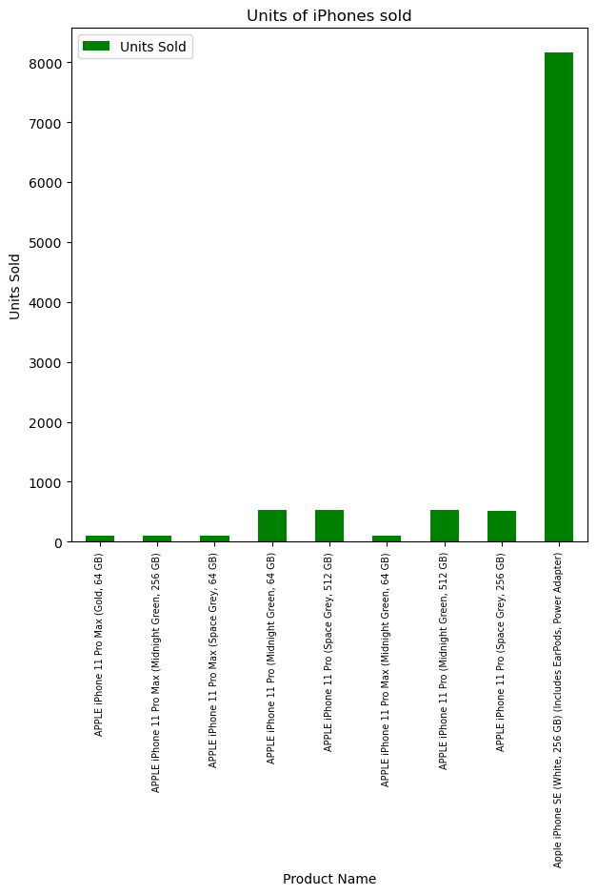
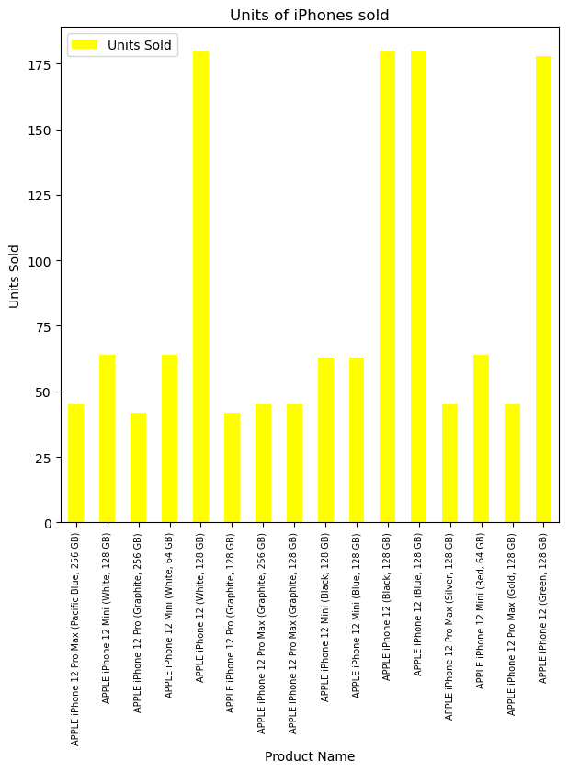
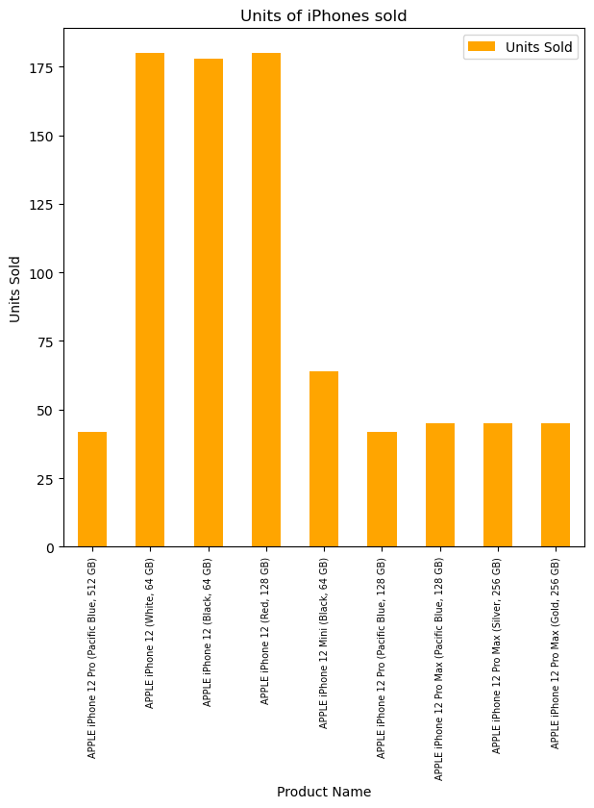
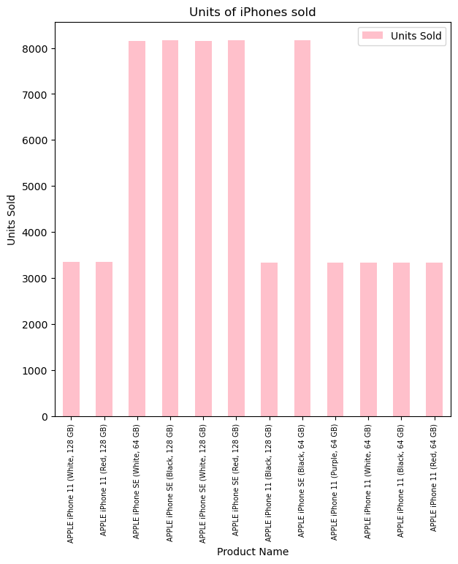
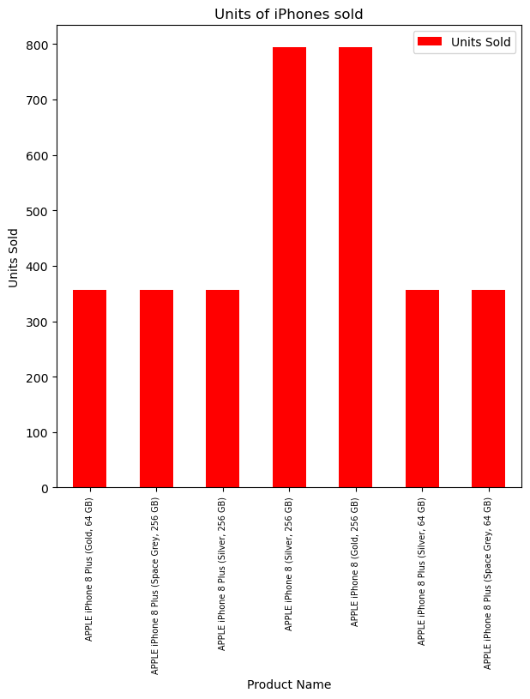
Data Visualization
Here you can see the no. of iPhone units sold on Flipkart after Apple shifted their manufacturing in India

Slide 13
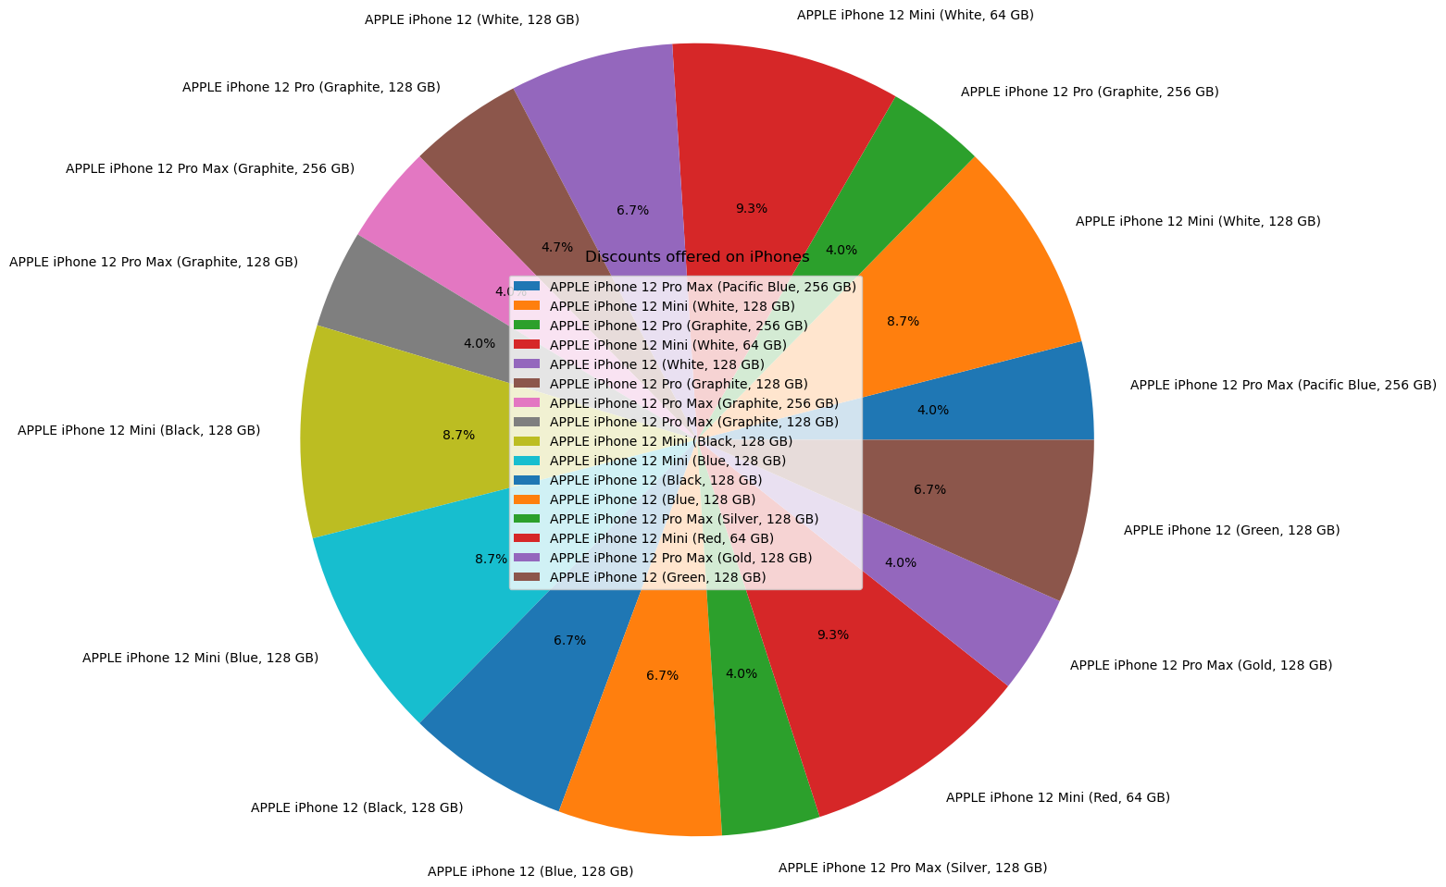
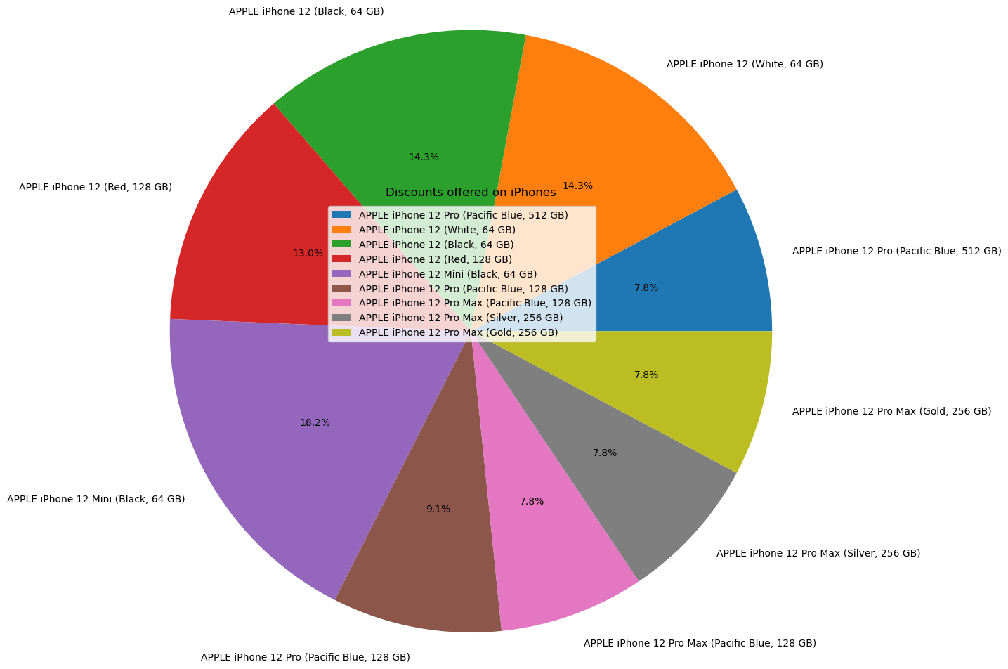
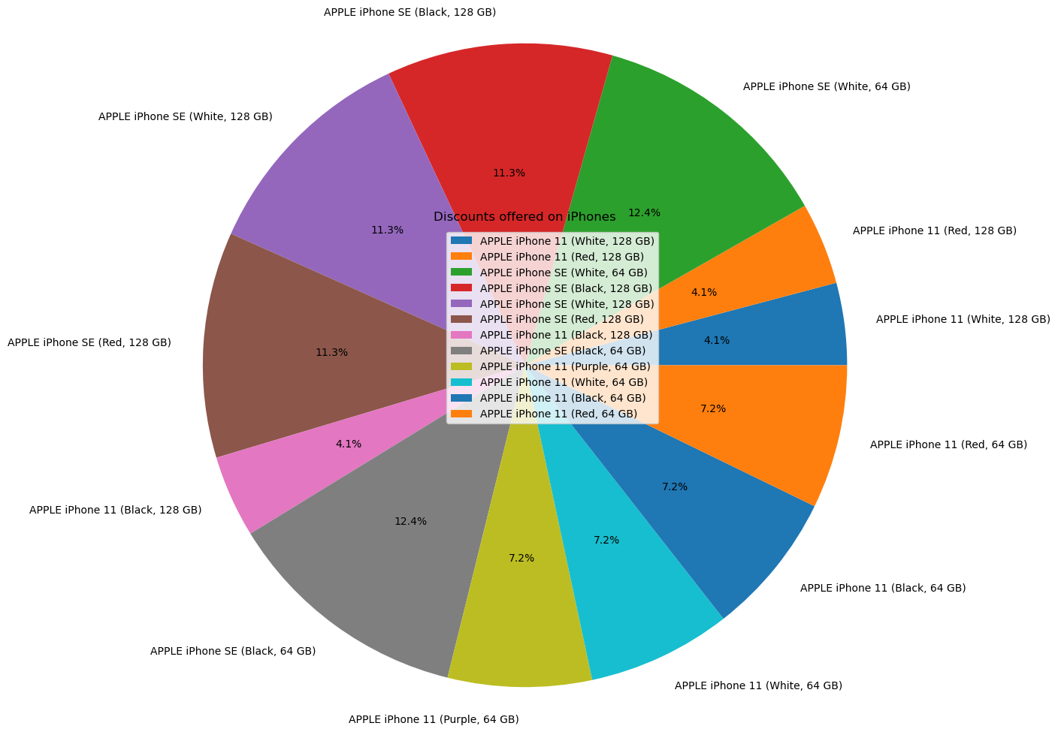
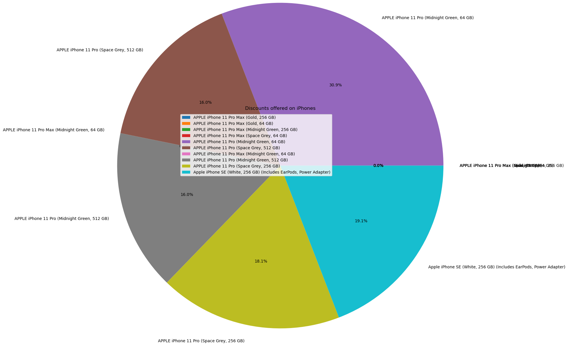
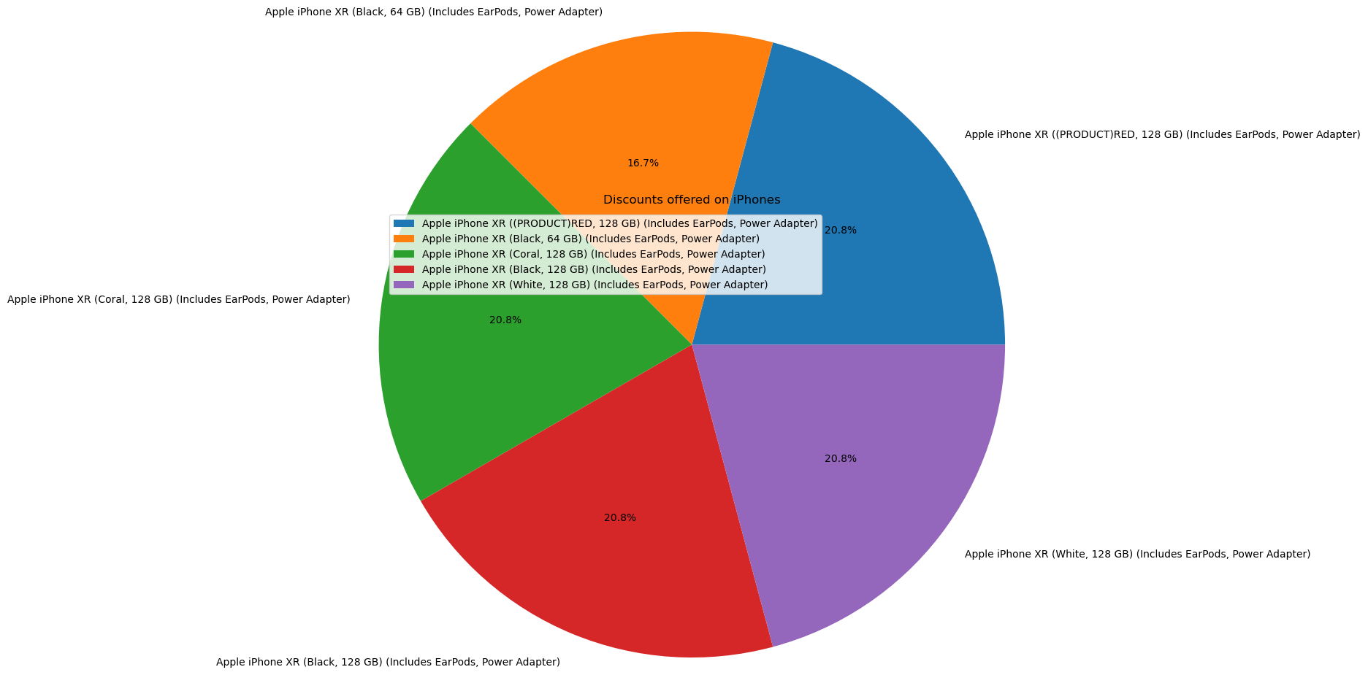
Data Visualization
Here you can see the discounts that were offered on iPhones after the setup of manufacturing unit in India

Slide 14
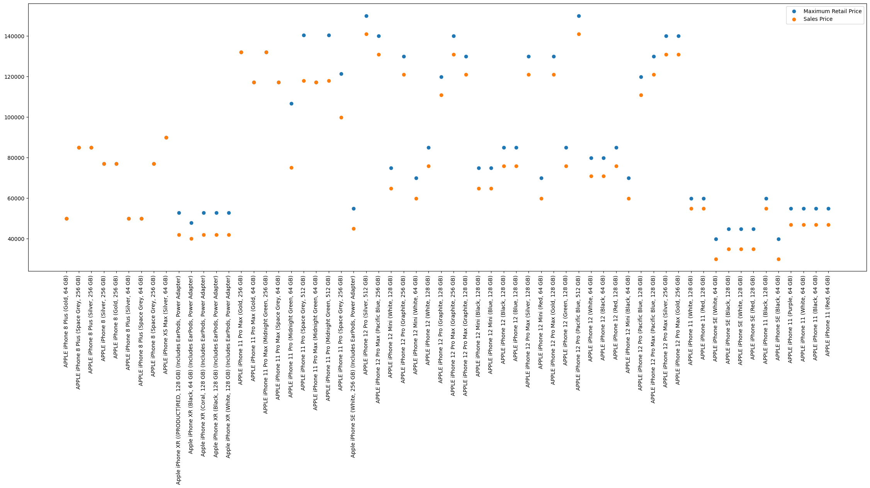
Data Visualization
Here’s a graph that shows the MRP and the sales prices of various iPhones after they were manufactured in India

Slide 15
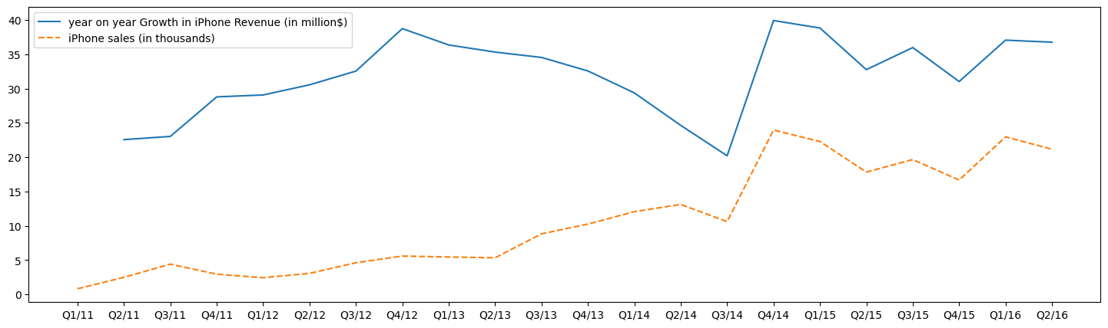
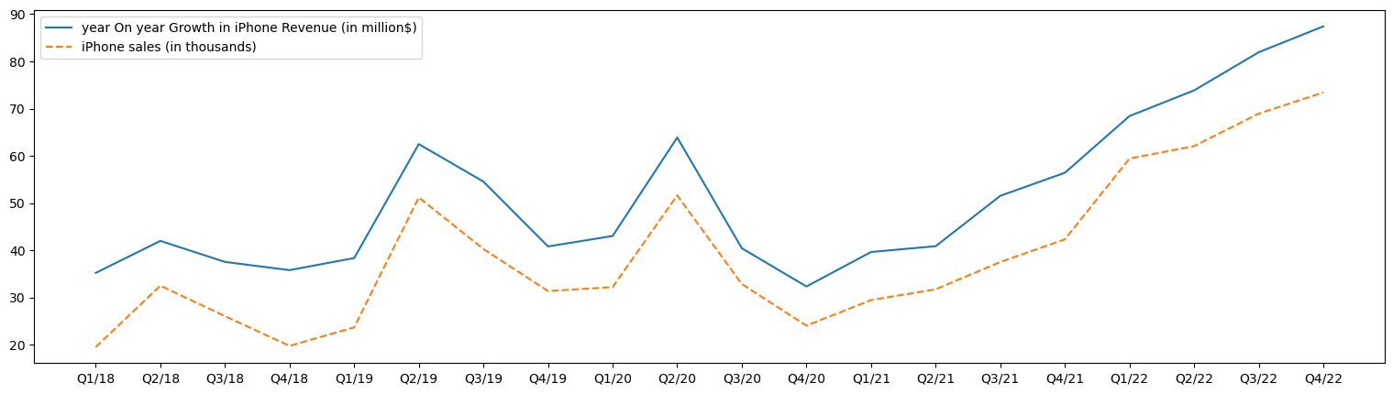
Data Visualization
Here we can compare the Quarterly sales and revenue data of iPhones before and after they were manufactured in India.
Before
After

Slide 16
Thank You
References
https://en.wikipedia.org/wiki/Apple_Inc.
https://www.dnaindia.com/technology/report-apple-iphone-in-india-likely-get-cheaper-as-government-announces-relief-for-manufacturers-3020765
https://data.world/rflprr/iphone-sales/workspace/project-summary?agentid=rflprr&datasetid=iphone-sales
https://www.indiatoday.in/technology/news/apple
https://pandas.pydata.org/
https://matplotlib.org/
https://qz.com/apples-indian-iphone-shipments-show-shift-from-china-1849968683#:~:text=India's%20business%2Dfriendly%20policies%20for,expensive%20model%2C%20the%20iPhone%20SE.&text=In%202020%2C%20it%20began%20manufacturing,linked%20incentive%20(PLI)%20scheme.

